Slide 1

Azure Inventory Solution for Greenwood Leflore Hospital
Zachary Blaine-Atkins, Quintin Covington, Charles Hohl, Phillip Jones Sr.
This Photo by Unknown author is licensed under CC BY-NC-ND.

Slide 2

Inventory Management Challenges in Small Rural Hospitals
Problem Description:
Stockouts: Delayed treatments and risks to patient health.
Overstocking: Ties up valuable financial resources.
Expired Supplies: Results in waste and increased operational costs.
Affected Parties:
Patients: Experience delays in care due to inventory shortages.
Healthcare Providers: Face increased workload managing inventory manually.
Hospital Administrators: Deal with inefficient processes and financial strain.
Measurable Impact:
Operational Costs: Increased by 10-15%.
Treatment Delays: Negatively affect patient outcomes.
Supply Waste: 5-10% of medical supplies wasted due to expiration.

Slide 3
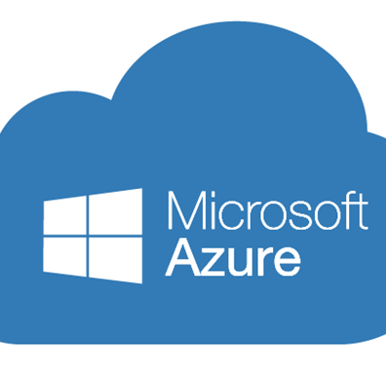
Microsoft Azure Cloud Integration
Real-time Inventory Management: Track and manage inventory with Azure IoT and AI.
Automated Alerts/Replenishment: Get alerts for low stock and expiration, and automate reordering.
Data Analytics: Predict inventory needs.
Secure Data Storage/Access: Ensure secure, compliant, and accessible data.
Business Case:
Target Market: Small rural hospitals with inventory challenges.
Value Proposition:
Cost Reduction: Optimize inventory, reduce waste, prevent stockouts.
Improved Patient Care: Ensure necessary supplies are available.
Operational Efficiency: Streamline processes and reduce admin work.

Slide 4

Implementation and Expected Benefits
Summary:
Implementing Microsoft Azure for inventory management enhances efficiency, reduces costs, and improves patient care in small rural hospitals.
Expected Benefits:
Financial Savings: Optimized inventory reduces costs.
Better Patient Outcomes: Improved satisfaction and care.
Streamlined Processes: Frees up staff for patient care.
We recommend leveraging Azure's capabilities to transform inventory management in small rural hospitals.

Slide 5
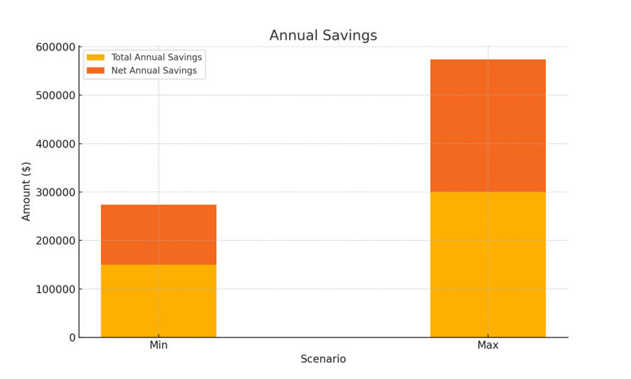
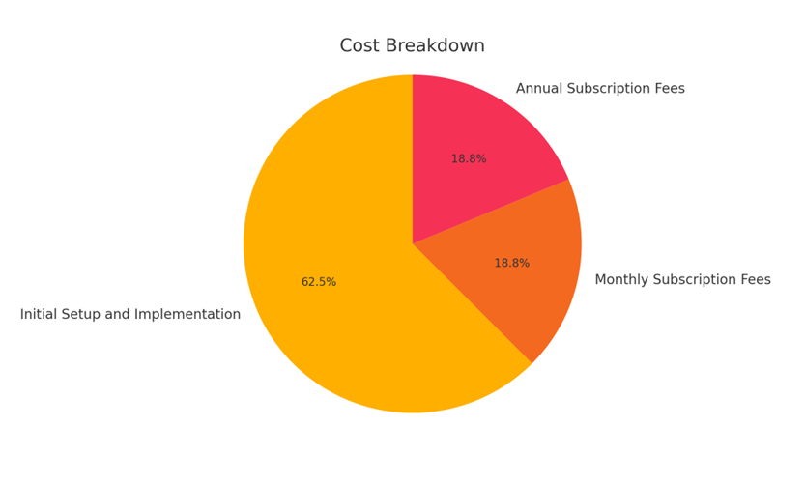
Greenwood Leflore Financial Analysis

Slide 6

Financial Metrics
Total Cost of Ownership
$26K, first year
$6K, annual costs
Net Present Value
Avg annual net savings - $199K
Approx. $809,602
Return on Investment
1890%
Payback Period
Within first year

Slide 7

Architecture and Core Components
Key Components:
IoT Devices for Real-Time Tracking
AI for Predictive Analytics
Secure Cloud Storage
Web-Based Dashboards for User Interaction

Slide 8

IoT Integration
Azure IoT Hub:
Connects IoT devices in hospital storage locations.
Continuously monitors stock levels and sends real-time data.
IoT Devices:
Sensors and RFID tags track quantity and location of supplies.
Communicates with Azure IoT Hub for inventory updates.

Slide 9
Real-Time Inventory Management
Azure Stream Analytics:
Processes real-time data from IoT devices.
Triggers alerts when stock levels are low.
Azure Functions:
Automates responses to alerts.
Actions include creating replenishment orders or notifying staff.

Slide 10

Predictive Analytics
Azure Machine Learning:
Analyzes historical data to predict future inventory needs.
Factors: Seasonal trends, usage patterns, upcoming events.
Azure Data Lake Storage:
Stores large volumes of historical inventory data.
Supports training and prediction by machine learning models.

Slide 11

Data Storage and Security
Azure SQL Database:
Secure storage for structured inventory data.
Ensures compliance with healthcare regulations like HIPAA.
Azure Blob Storage:
Stores unstructured data such as logs and records.
Provides scalable and cost-effective storage solutions.
Azure Key Vault:
Manages secrets and keys for data protection.
Ensures secure access to the inventory system.

Slide 12

User Interaction
Power BI:
Creates interactive dashboards and reports.
Provides insights on inventory levels, shortages, and trends.
Azure App Service:
Hosts web applications for system interaction.
Allows ordering, reporting, and inventory management.
Microsoft Teams Integration:
Facilitates communication and collaboration among healthcare providers.
Provides notifications within their workflow.

Slide 13

Data Flows and User Interactions
Data Flow
Data Collection: IoT devices send data to Azure IoT Hub.
Real-time Processing: Azure Stream Analytics processes data, triggers Azure Functions.
Storage and Analysis: Data stored in Azure SQL Database and Data Lake for analysis.
Predictive Insights: Machine learning models provide insights via Power BI.
User Interaction: Users interact through Azure App Service and receive Teams notifications.

Slide 14

Security and Privacy
Data Encryption:
All data encrypted at rest and in transit.
Access Control:
Role-based access control (RBAC) for authorized access.
Compliance:
System complies with healthcare regulations, including HIPAA.

Slide 15

Critical Challenges and Solution Overview
Challenges:
Stockouts, overstocking, expired supplies, financial strain, compromised care.
Solution:
Microsoft Azure cloud-based system with real-time tracking, predictive analytics, secure data management.
Outcomes:
Cost savings, operational efficiency, improved patient care.
This Photo by Unknown author is licensed under CC BY.

Slide 16

Why This is a Good Idea
Financial Impact:
Save $150,000 annually.
Patient Care:
Enhanced supply availability, better outcomes, higher satisfaction.
Scalability:
Supports growth, positions hospital as an innovator.
This Photo by Unknown author is licensed under CC BY-NC-ND.

Slide 17

Request for Funding
Initial Setup:
$20,000 for devices, Azure services, system development.
Ongoing Costs:
$500 monthly subscription, total annual cost $26,000.
Benefits:
Net annual savings up to $274,000, improved processes, strategic positioning

